Slide 1
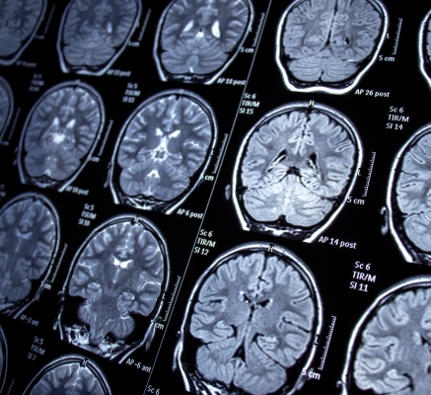

Enhancing Brain Tumor Detection in Low-Quality MRI Scans Using Transfer Learning
By Oulaya ELARGAB
202320310
Supervised by: Dr. Behzad Muzammil
27/04/2025

Slide 2
PLAN
INTRODUCTION
LITERATURE REVIEW
PROPOSED METHODOLOGY
EXPERIMENTAL DESIGN AND EVALUATION
EXPERIMENTAL SETUP
RESULTS COMPARATIVE ANALYSIS
EXTENDED CONTRIBUTIONS
CONCLUSION AND FUTURE WORK

Slide 3
INTRODUCTION
Background
Brain tumors are life-threatening and require early, accurate classification.
Manual MRI analysis is time-consuming and prone to variability.
Deep learning offers faster, more reliable tumor detection.
Challenges
Most current models are trained on clean, high-quality MRI scans.
Real-world clinical images are often noisy, degraded, or low-resolution.
Many models fail to generalize to these real-world conditions.
Problem Statement
Build a robust deep learning model for brain tumor classification.
Focus on handling noisy and degraded MRI scans.
Identify models best suited for real-world clinical use.

Slide 4

INTRODUCTION
Objectives
Improve tumor classification performance on low-quality MRI scans.
Build robust, generalizable models for practical medical applications.
Analyze how image quality impacts deep learning model robustness.
Support accurate, automated tumor diagnosis.

Slide 5
Scope of Work
Clean and preprocess MRI datasets.
Simulate degraded MRI conditions (noise, blur, downsampling).
Develop and enhance Transfer Learning models (VGG16, VGG19, ResNet50V2).
Tune hyperparameters and apply regularization.
Evaluate models using multiple metrics (accuracy, F1-score, confusion matrices).

Slide 6
LITERATURE REVIEW
Study | Contribution | Limitations
Sultan et al. (2019) | CNN with data augmentation; improved accuracy | Shallow network, no tumor localization
Seetha & Raja (2018) | CNN for tumor classification | No multi-view support, limited interpretability
Ari & Hanbay (2018) | Hybrid ELR-LRM model (deep learning + rule-based) | Too complex, poor generalization
Sobhaninia et al. (2018) | Organized MRI scans into sagittal, axial, coronal views | Better spatial understanding, no classification boost
Kadam et al. (2021) | 94% accuracy, F1-score 91% | Lacked localization and contextual analysis

Slide 7
PROPOSED METHODOLOGY
Models used: ANNs, CNNs, and Transfer Learning (TL).
Best performer: Fine-tuned VGG16, achieving:
94% Accuracy
91% F1-score
Existing Approach:
(Benchmark from Kadam et al., 2021)

Slide 8
Challenges Identified
Dependence on clean MRI images: Models trained only on high-quality scans struggled with real-world noisy or low-resolution data.
01
Sensitivity to image degradation: Poor performance when faced with motion blur, scanner noise, or low-quality imaging conditions.
02
Limited generalization: Lack of diverse image quality in training reduced reliability for broader clinical deployment.
03

Slide 9
Proposed enhancement
Data-Level Improvements
Simulated low-quality MRI data using:
Gaussian noise addition
Image blurring
Downsampling
Random application of one or more degradations per scan.
Dataset size doubled and diversity increased to improve model robustness under real-world imaging conditions.

Slide 10
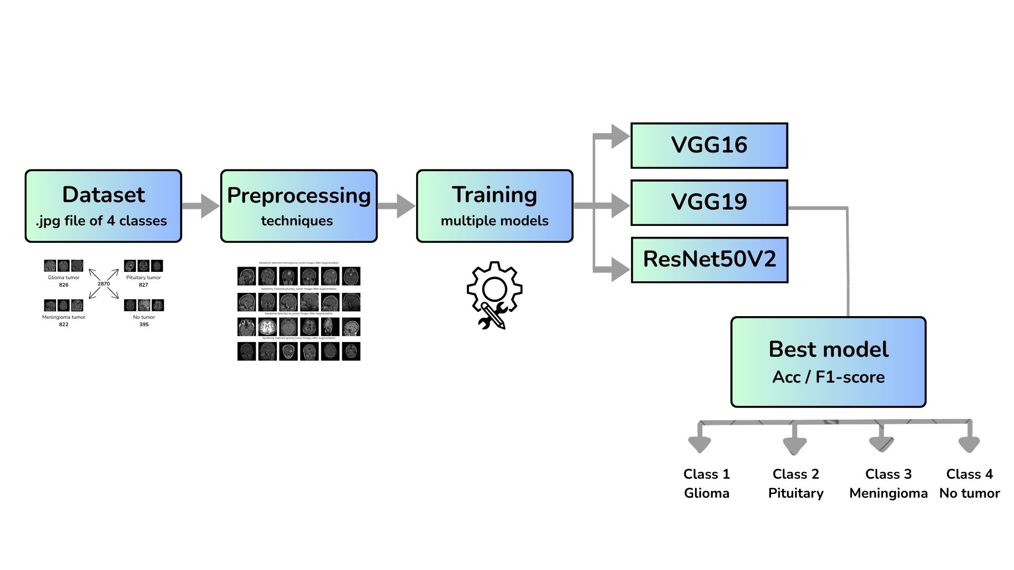
METHODOLOGY

Slide 11
Enhancing baseline models
Pretrained Model VGG16
VGG19
ResNet50V2
Freeze Base Layers
(Feature Extractors)
Add Custom Classification Head
Dense Layers (ReLU)
Dropout
Softmax
Output (4 Classes)
Extra Dropout + LR Scheduling
Train with Early Stopping + Categorical Cross-Entropy Loss

Slide 12
Algorithm and Implementation
Aspect | Description
Models Used | VGG16, VGG19, and ResNet50V2 pretrained on ImageNet
Architectural Modifications | Top layers removed; added custom classification heads with global average pooling, dense layers, dropout, and softmax output
VGG16/VGG19 Head | Global Average Pooling → Dense (1024) → Dropout (0.5) → Dense (512) → Dropout (0.5) → Softmax (4 classes)
ResNet50V2 Head | Global Average Pooling → Dense (1024, ReLU) → Dropout (0.5) → Softmax (4 classes)
Special Features | Residual connections in ResNet50V2 enable deeper learning and reduce vanishing gradients
Input Size | 224×224 pixels
Data Augmentation | Gaussian noise, blurring, and resolution downsampling

Slide 13
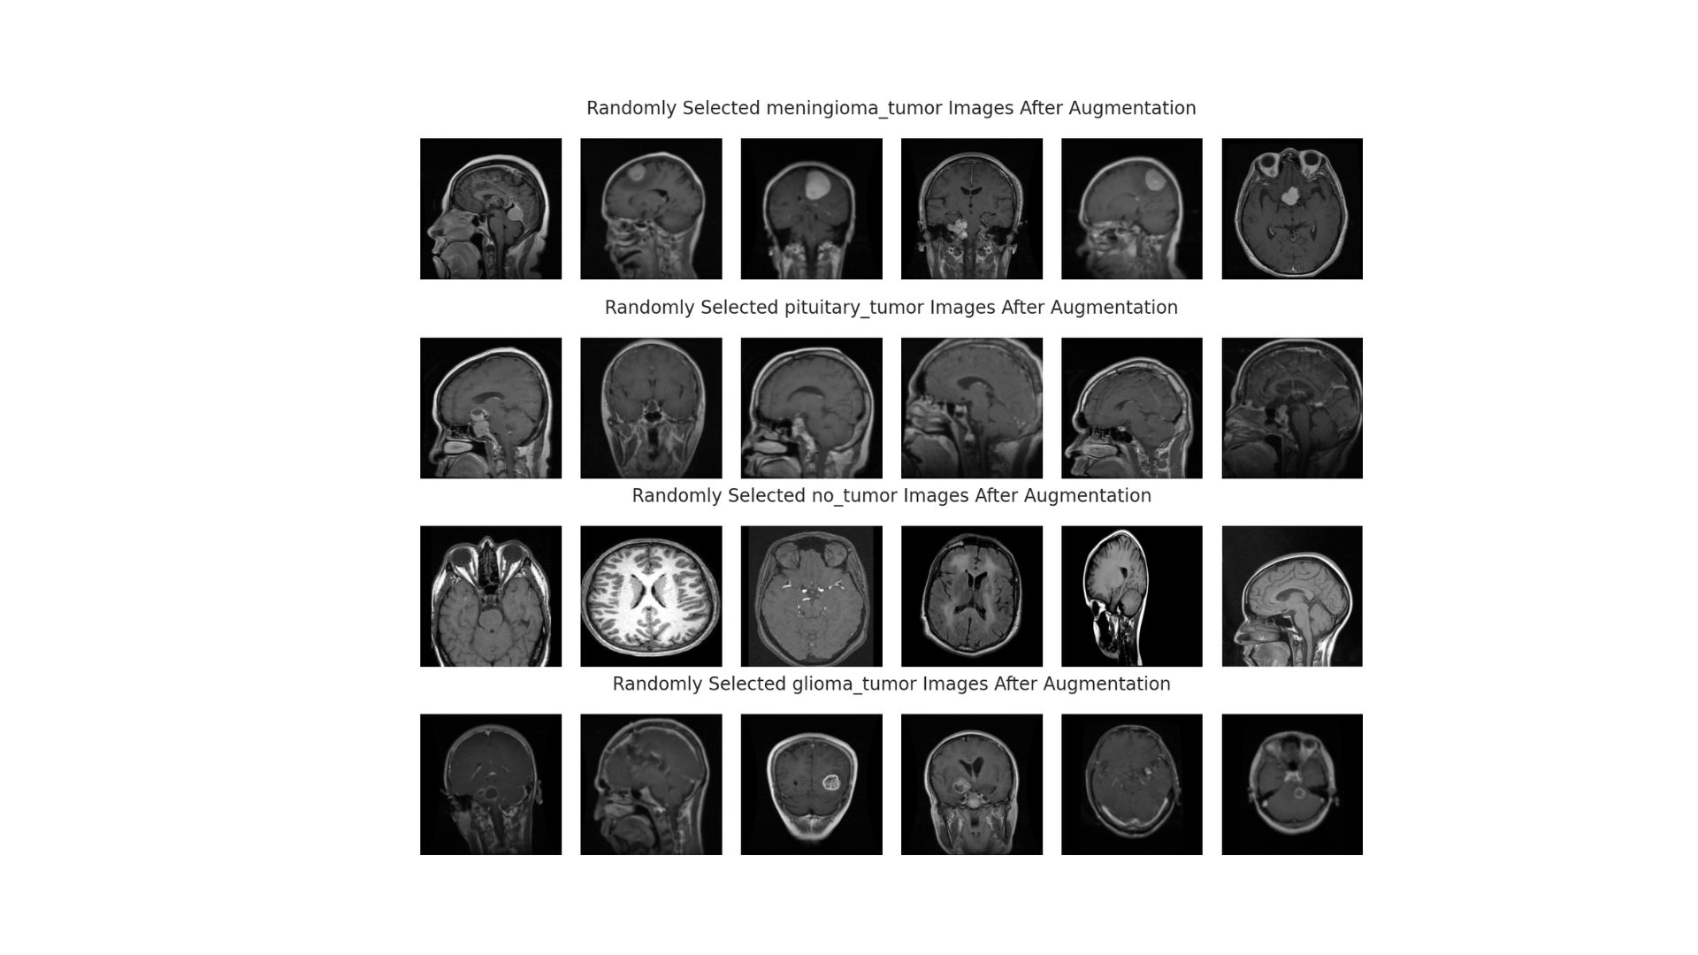

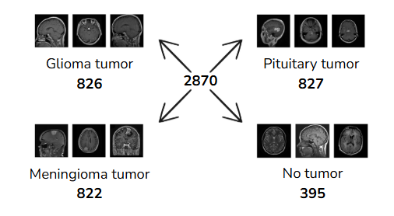
EXPERIMENTAL DESIGN AND EVALUATION
Aspect | Description
Source | Kaggle (2021) Brain Tumor Dataset
Total Images | ~2,870 MRI images
Class Distribution | - Pituitary Tumor: 827 images (28.82%) - Glioma Tumor: 826 images (28.78%) - Meningioma Tumor: 822 images (28.64%) - No Tumor: 395 images (13.76%)
Class Imbalance | The "No Tumor" category is significantly underrepresented
Preprocessing | All images resized to 224×224 pixels to match model input requirements
Datasets and Preprocessing
the training set expanded from 2,296 to 4,592 images, and the validation set grew from 574 to 1,148 images.

Slide 14


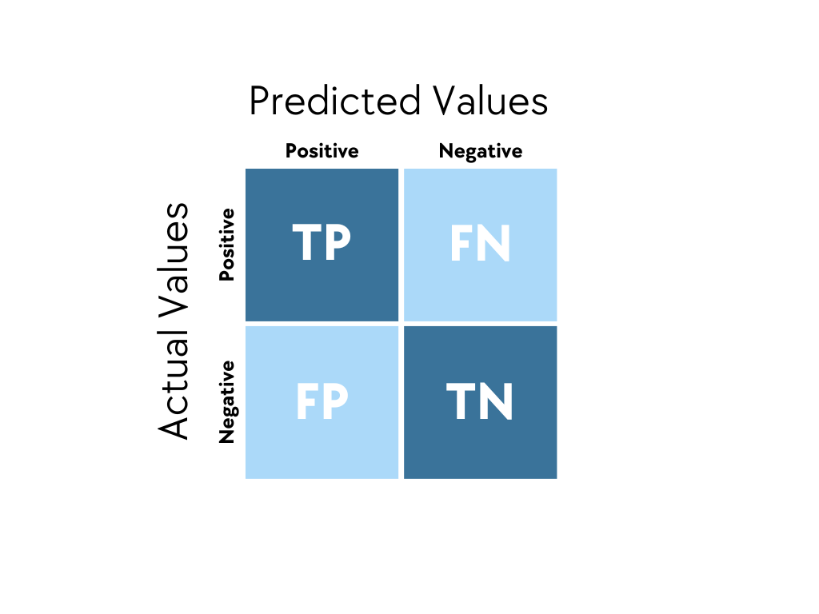
EVALUATION METRICS
Accuracy (Acc): measures the overall effectiveness of a model by calculating the percentage of correct predictions across all classes, reflecting its general performance.
F1-Score: provides a balanced evaluation of a model’s precision and recall by calculating their harmonic mean, making it especially useful when dealing with class imbalance or when both false positives and false negatives are critical.
Confusion Matrix: is a structured table that compares actual and predicted labels, providing both overall accuracy and detailed class-wise performance insights by highlighting patterns of correct and incorrect classifications.

Slide 15


EXPERIMENTAL SETUP
Dataset Handling
Kaggle MRI dataset split into 80/20 stratified training/testing sets.
All images resized to 224×224 pixels to match model input requirements.
Pretrained Models
VGG16, VGG19, ResNet50V2 (ImageNet feature extractors).
Custom Classification Heads:Global Average Pooling → Dense Layers (ReLU) → Dropout → Softmax (4 classes).

Slide 16
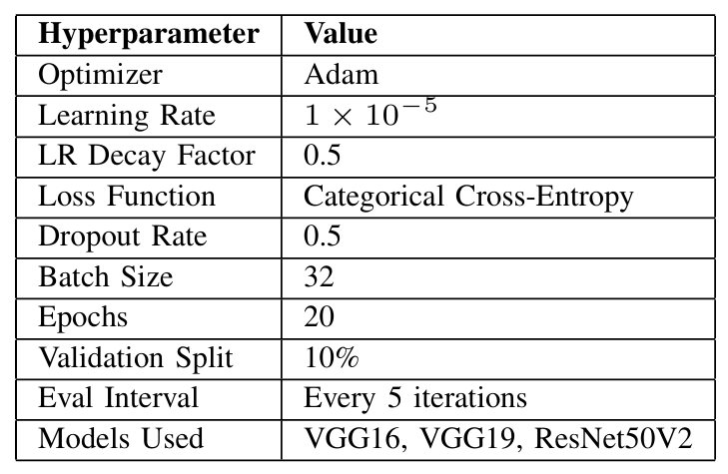
Training Configuration

Slide 17
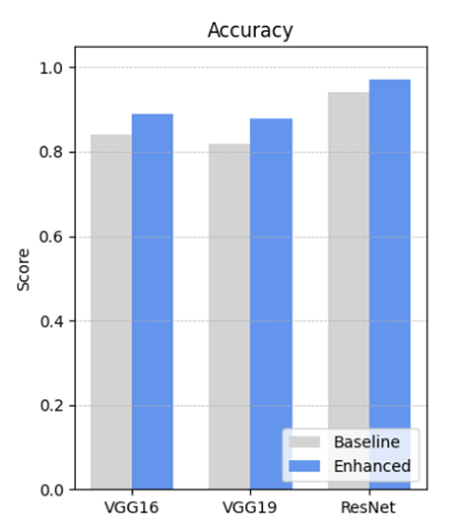
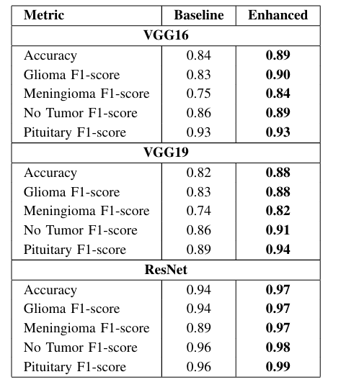
RESULTS COMPARATIVE ANALYSIS

Slide 18
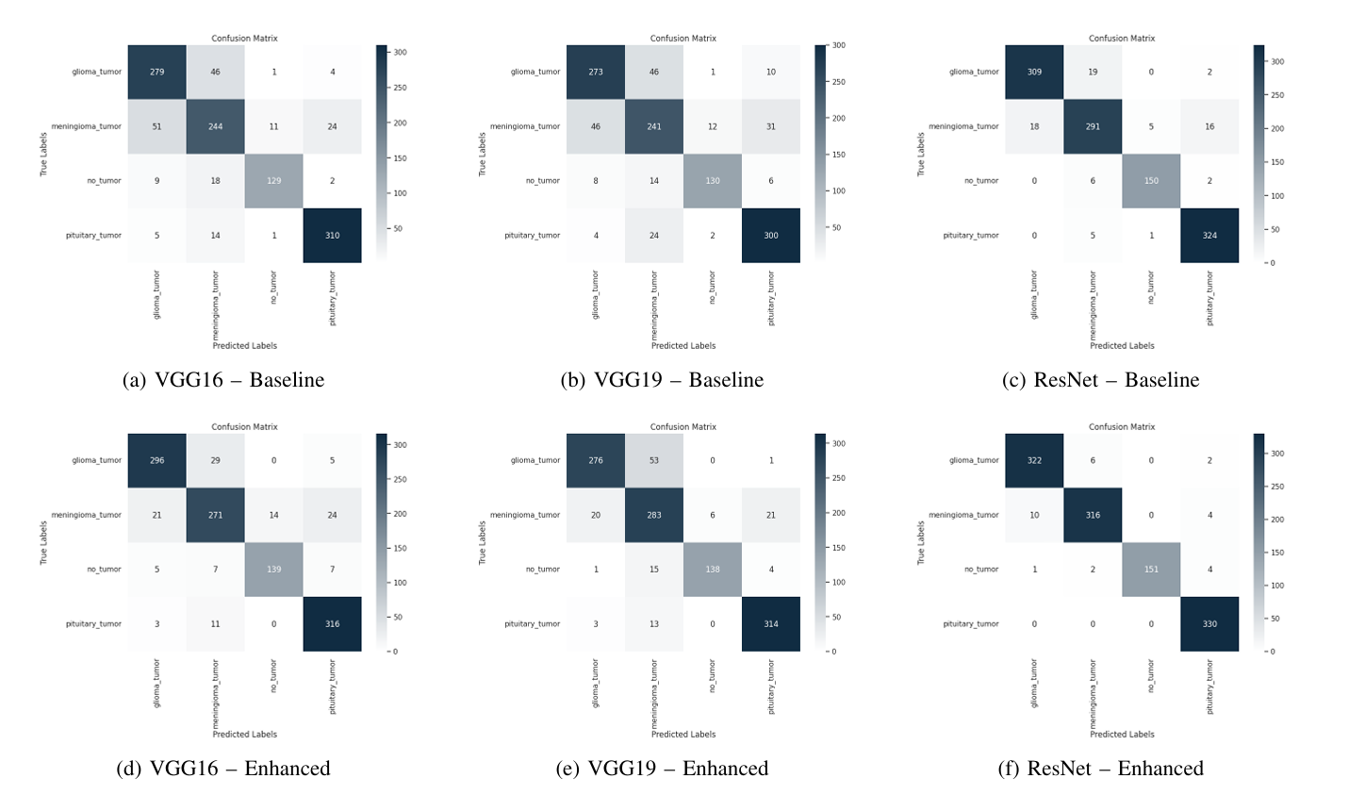
Confusion matrices

Slide 19
EXTENDED CONTRIBUTIONS
Making Models More Robust
Supporting Low-Resource Settings
Adaptable Framework for Other Medical Tasks
Helping Future Research and Learning
Promoting Realistic Testing Standards

Slide 20
CONCLUSION
Enhanced transfer learning models (VGG16, VGG19, ResNet50V2) were evaluated for brain tumor classification under degraded MRI conditions.
Deeper classification heads, dropout regularization, and training on degraded images led to consistent performance improvements over baseline models.
ResNet50V2 achieved the highest accuracy and F1-scores, showing strong potential for reliable use in clinical environments.
Emphasis was placed not just on accuracy, but on generalization to noisy, blurred, and low-resource imaging scenarios.

Slide 21
FUTURE WORK
Expand datasets by including images from different scanners, institutions, and diverse demographics to improve generalizability.
Deploy models on mobile or web-based diagnostic platforms to assess real-time performance in resource-limited settings.
Integrate multi-modal data (e.g., clinical notes, genetic information) for more comprehensive and accurate tumor diagnosis.

Slide 22

Oulaya ELARGAB
27/04/2025

